Slide 1
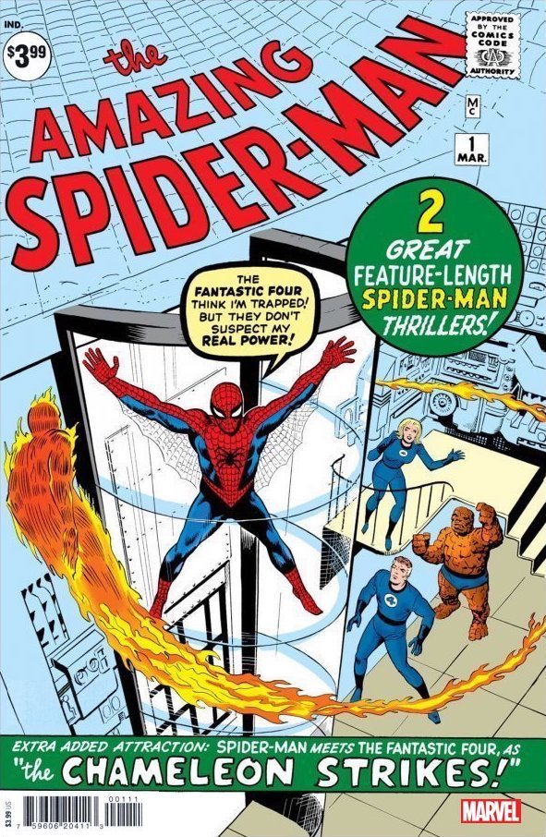
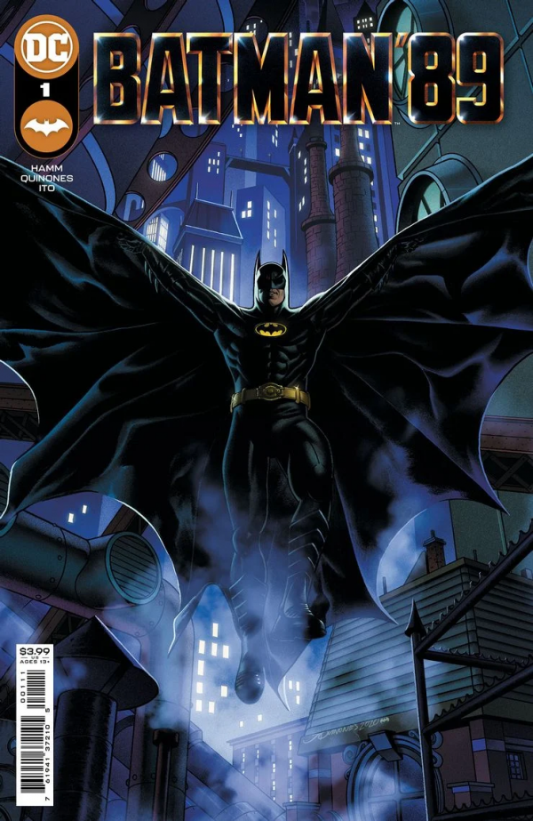
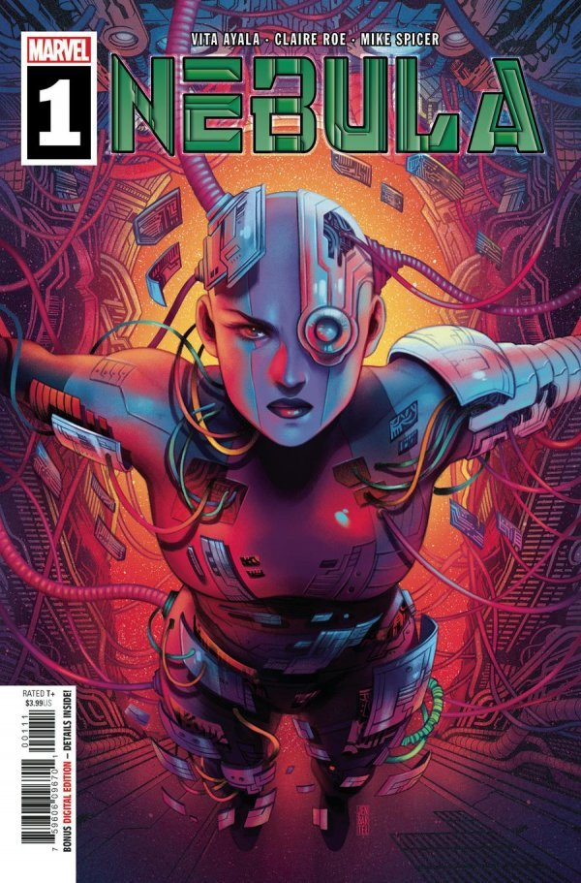
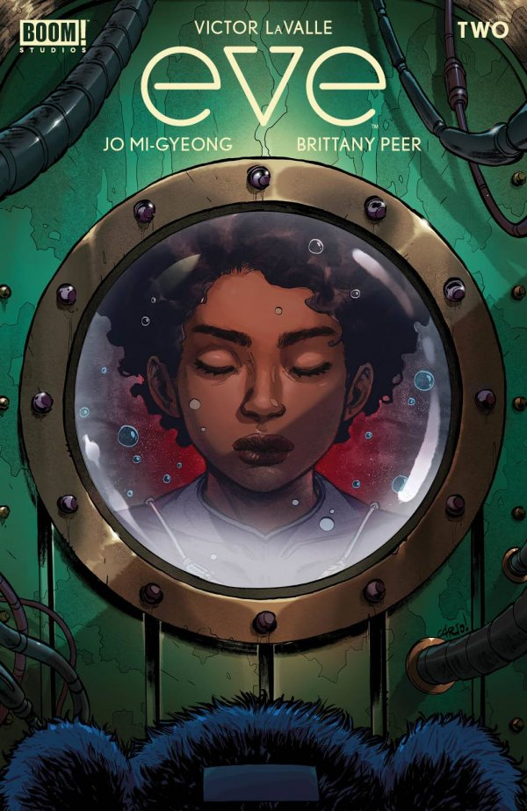
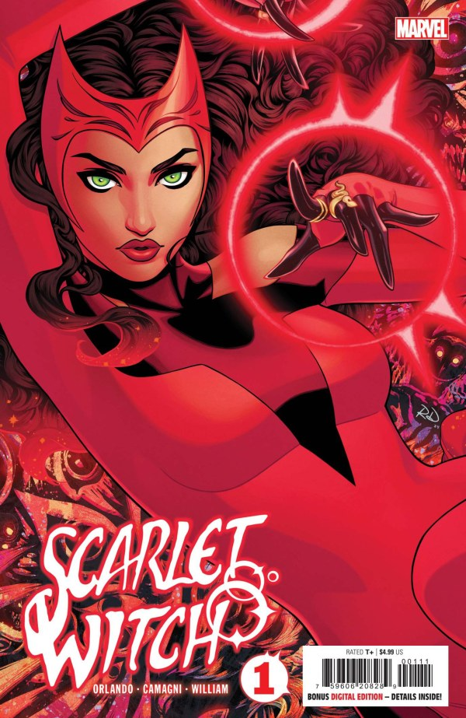

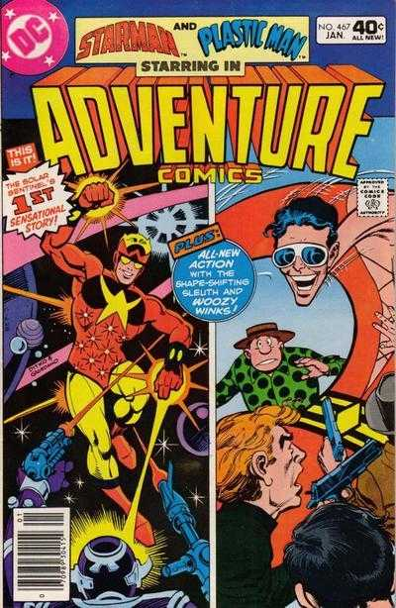
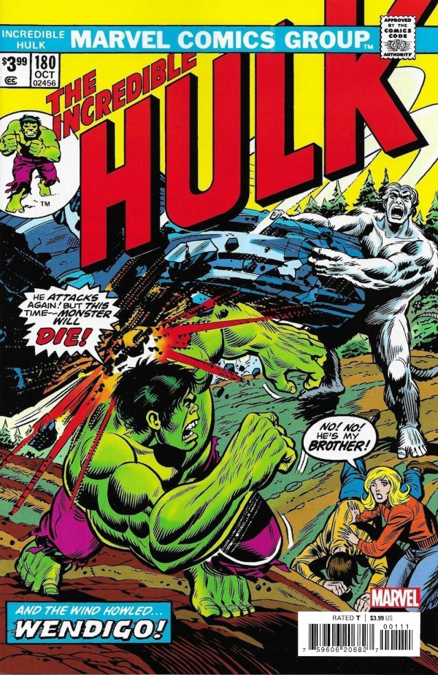
My Comic Book Collection
As of Dec 14, 2024

Slide 2
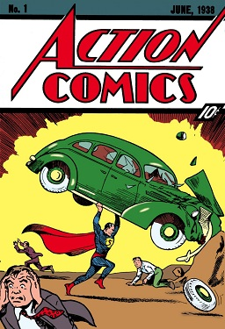
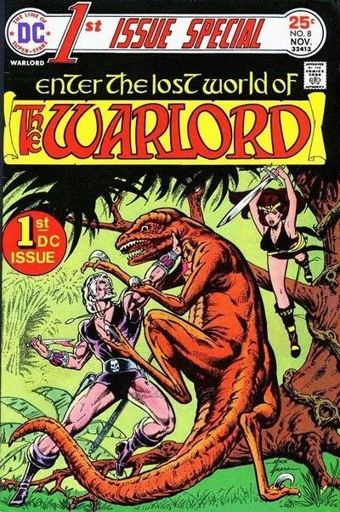
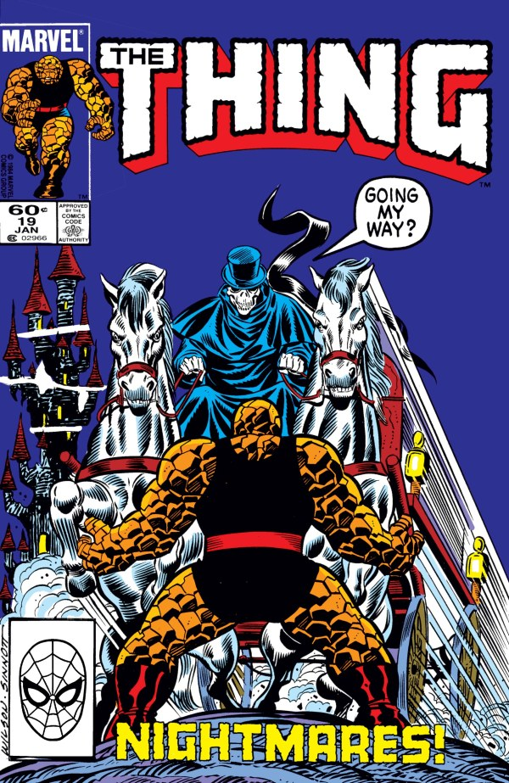
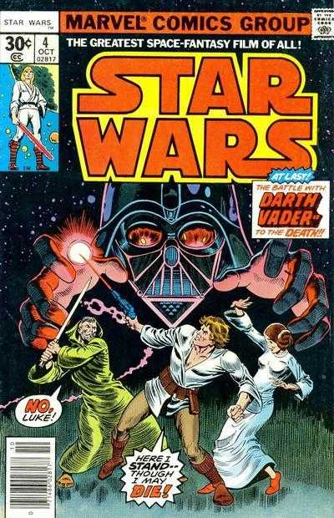
Comic Books
Comic books started in 1938 with the introduction of Action Comics #1 marking the debut of Superman. Over the years, comic books have sold for over $3.5M, making comic books investment-grade collectibles.

Slide 3

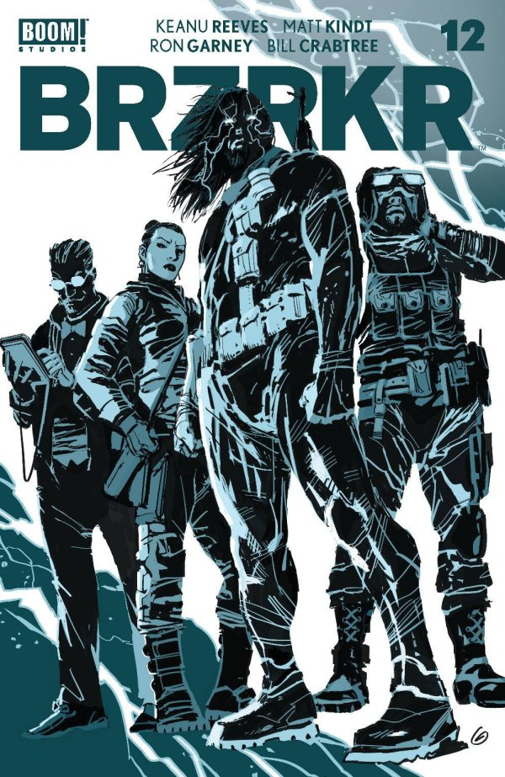
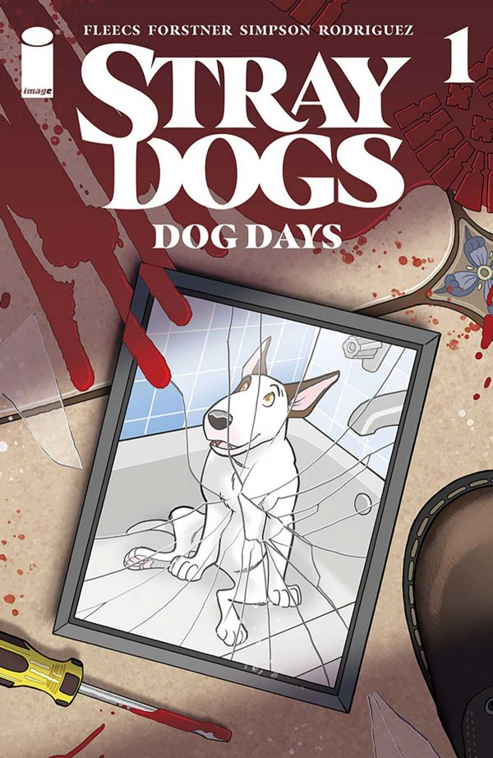
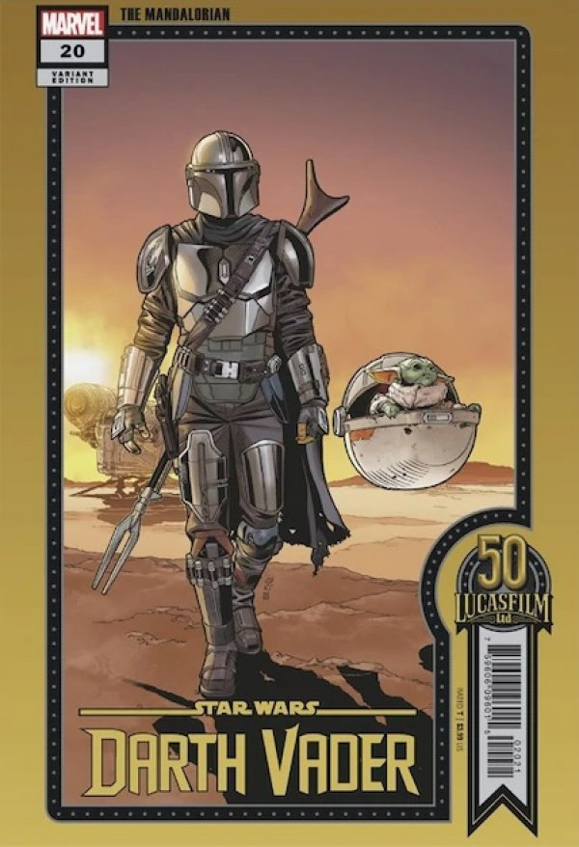
My Comic Books
I started collecting July 4th, 2021, and fell in love with the stories and artwork. I quickly learned certain artists and rarity of the covers could increase a book’s value ten-fold in the first day.

Slide 4
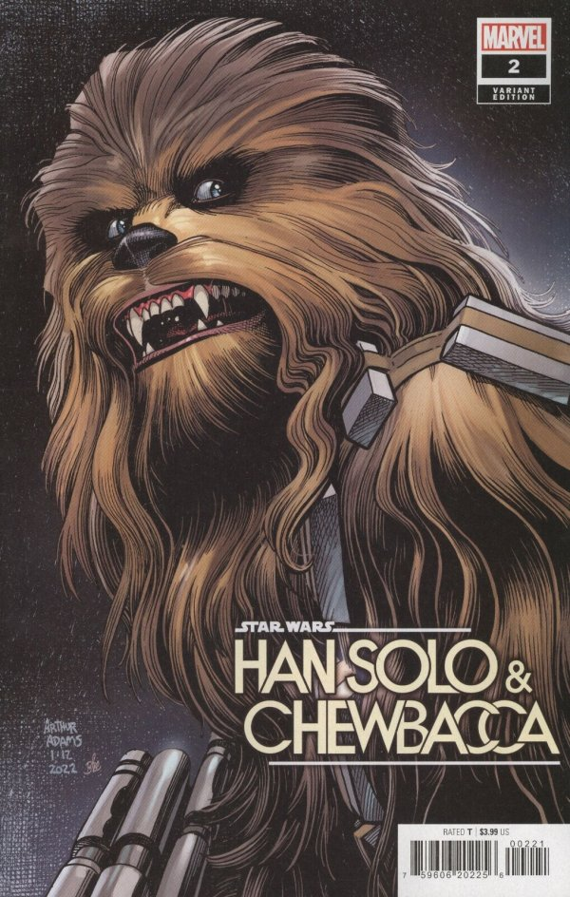
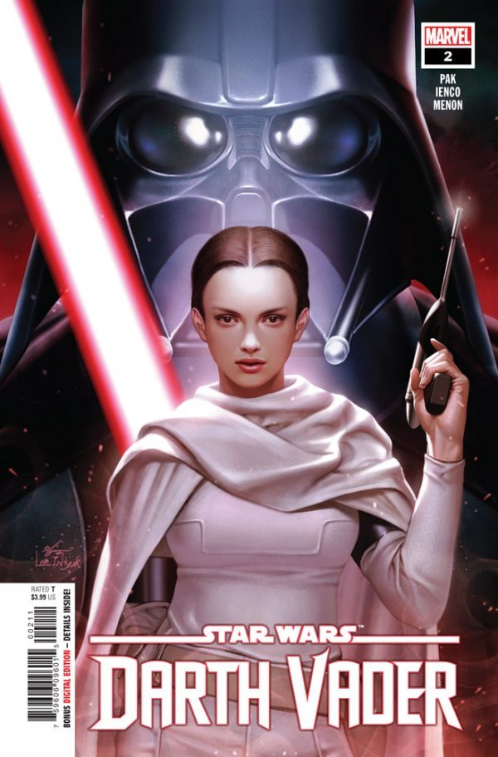
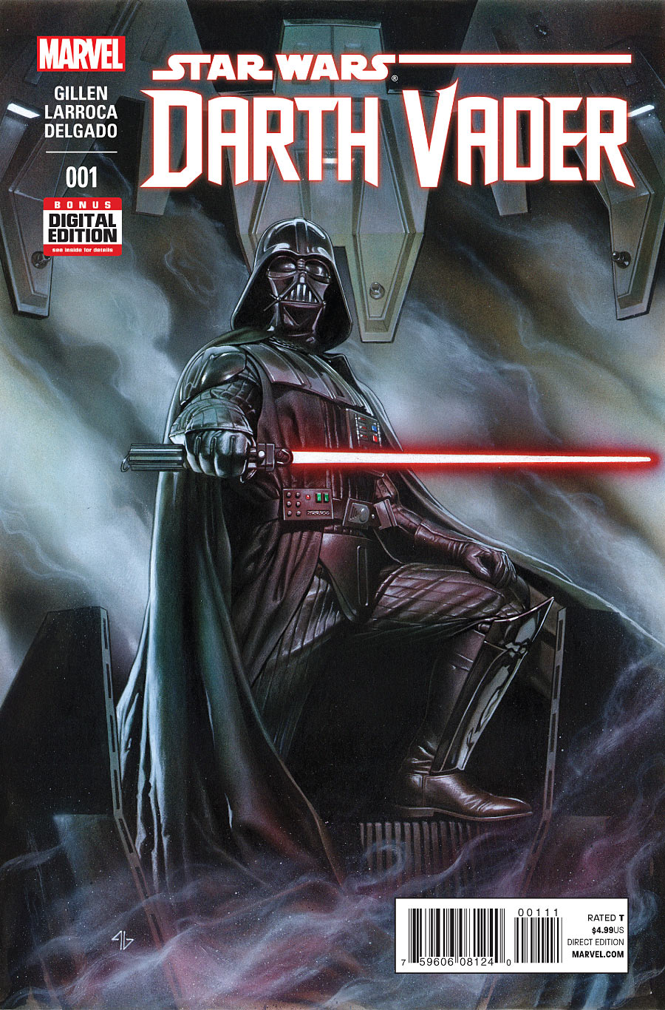
My Comic Books
As a Star Wars fan, the stories from the comics fill much of the gaps between the movies and TV shows. We get to see our beloved heroes, and villains, in their natural elements like we never see on the screen.

Slide 5
My Collection
The following are some stats from my collection

Slide 6
by publisher
This is so high due to Star Wars
Contains more original stories (better in my opinion)

Slide 7
release years
That was an expensive year
Started Collecting

Slide 8





reading status

Slide 9

star wars comics
All other books
33%
Star Wars
67%
2

